Slide 1
Assignment 5 Hints

Slide 2
Disclaimer
More programming involved in this assignment, and there are multiple ways to solve some of these problems.
The ideas shown here are just one possible way
Either way – remember to track your work via Git

Slide 3
Overall Approach
Try to break this homework down into small steps. This is one possible way to do it:
Download the .tgz, unpack it, clone it, build it, and make sure it works
Briefly review the code and Makefile
Figure out how to have Make Check test your code
Figure out how to break apart file, and have everything still work as is
Figure out how to add and parse extra command line options with getOpt
Implement each command line option
-i options: mrand48, rdrand, and /F
-o options: stdio, write call
Figure out how to compile it all with a MakeFile
Optimize (reduce include headers to minimum necessary, etc)

Slide 4
Step 1 – Download randall tar and run
Download from website and extract it into a folder.
tar -xzvf randall-git.tgz
Clone it into a new directory for you to work off
git clone <extracted_folder> <working_folder>
If you don't have a recent version of gcc installed locally, you may want to do this work on SEAS
After you extract, compile the executable and test it!
make randall
./randall <number of bytes to output>
If it is hard to see the number of bytes printed, try to pipe to 'od –ta' for visibility
./randall 10 | od -ta

Slide 5
Step 2 – Review the code and Makefile
Try to pay special attention to things that you will need to modularize later:
How are random numbers generated and functions used
How are random bytes output
Try to pay special attention to Makefile and how it compiles code

Slide 6
Step 3 – Write a test with Make Check
First come up with test. Check that randall output the correct number of bytes:
i.e. './randall 5' should output 5 characters
What might this test look like in bash?
a=$(./randall 5 | wc -c); if [ $a -eq 5 ]; then echo "success"; else echo "fail"; fi
How can we incorporate this into Make Check?
Put all our bash tests into a shell script (just one test right now)
Create a 'check' target in Makefile
Call this shell script from the 'check' target

Slide 7
Step 4 – Break Apart Code - General
Remove 'static' keyword from function definitions
Remember how to do file management for C projects:
.c files are implementation files. They implement your source code and main
.h files are header files. They contain function prototypes
Protect header files with header guards
General practice:
Only #include .h files for access to function definition
Then compile together .c files for implementation
Compile as you go, to catch errors early

Slide 8
Step 4 – Break Apart Code - Options
Have a options.c which parses command line inputs and returns that back to the main portion of your code
For now – just try to extract the part which determines the nBytes to print
Later you can expand this section to parse more options

Slide 9
Step 4 – Break Apart Code - Output
What parts of the code are responsible for outputting random bytes?
writeBytes() – takes in a random number and writes bytes from that
Do-while loop that continuously calls writeBytes until enough bytes are written
What needs to move to output.c?
For now - just try moving writeBytes() to output.c
By the end of the assignment – you may want to move both parts

Slide 10
Step 4 – Break Apart Code – rand64
What parts of the code are responsible for creating random numbers?
software_rand64_init()
software_rand64()
software_rand64_fini()
Note - Same for hardware
Notice also how they get used later with function pointers, shown in next slide.
Try to split the 3 respective functions for hardware/software into their own respective slide

Slide 11
Step 4 – Break Apart Code – rand64 – Cont.

Slide 12
Step 4 – Break Apart Code – randall
Any remaining glue code can stay in randall.c
Modify randall.c to call all the functions you moved to their own modules/headers
Now build and verify that the test you wrote in 'make check' still works!
Can build with basic compiler command to start:
gcc [options from makefile] randall.c output.c options.c rand64-sw.c rand64-hw.c -o randall

Slide 13
Step 5 – Read extra options
getOpt is a library to make it easy to extract Command Line options:
What do you need to extract?
-o , optional argument
-i , optional argument
What is left that getOpt did not parse?
nBytes , original positional argument
Sample usage of program now:
./randall -i mrand48_r -o stdio 10
./randall -i rdrand -o 5 10
./randall 10
Where to learn more about getOpt
LA's made some good slides that are at the end of this presentation as an "Appendix"
Documentation linked in assignment is good too

Slide 14
Step 5 – Read extra options – Cont.
How to return all the parsed options back?
Many possible ways, I would use a struct.
See example on next page of:
Creating a struct
Passing the struct to a function as a pointer
Function fills the struct, and you can then access back in original function

Slide 15
Step 5 – Read extra options – Cont.

Slide 16
Step 6 – Implement –i options - rdrand
Use the hardware functions already defined if available, otherwise error
Check rdrand_supported() function

Slide 17
Step 6 – Implement –i options - /F
Right now, software_random code always reads from /dev/random
Give user a chance to name their own file to open and read from

Slide 18
Step 6 – Implement –i options - mrand
This one will require more work than previous 2
Check slides in appendix for usage/example of mrand
Your goal is to still break it down into 3 functions similar to software/hardware random number generator:
mrand_rand64_init()
mrand_rand64()
mrand_rand64_fini()
Note – mrand on its own does not make a 64 bit number like our other random functions do. But its fine for grading if you just cast it to an unsigned long long.
If you are looking for a challenge and took CS 33, try to think how you could use mrand to make a 64 bit number!

Slide 19
Step 6 – Implement -o options - stdio
This is how it works now! (using putchar)
No work required here ☺

Slide 20
Step 6 – Implement -o options – write N
Need to replace putchar with the write system call
General idea:
You need to write N bytes at a time to stdout
Malloc a buffer (array) to store your random bytes
Once you have the correct number, use a single write call to write the whole buffer
Keep track of how many bytes in total you have written, so you can stop when the total number has been reached
Pseudocode on next slide

Slide 21
Pseudocode
//Example usage is: ./randall -o 15 50
//Implies Write 50 bytes total, in blocks of 15 at a time
If -o option is not stdio
totalWritten = 0
requiredToWrite = 50
bufferSize = 15
currentArrayIndex = 0
Malloc a buffer (char array) big enough to hold bufferSize chars
//Generate random numbers and print them
while totalWritten is less than requiredToWrite
Generate random number x
//check if last write needs to be smaller than normal to not go over requiredToWrite
if totalWritten + bufferSize > requiredToWrite
bufferSize = requiredToWrite - totalWritten
//Put random chars in buffer
while x > 0 && currentArrayIndex < bufferSize
put x in buffer at current array index and increment
bitshift x (x >>= CHAR_BIT)
//Print the buffer, keep track of how many were written
if buffer is now full
bytesWritten = write N bytes from buffer to stdout
totalWritten += bytesWritten
currentArrayIndex = 0 currentArrayIndex = 0

Slide 22
Step 7 – Build using a Makefile
First try to figure out how to compile file via command line. Then convert that series of commands to your Makefile.
One easy way, but NOT efficient, is to lump them all together
gcc -o randall [other options] randall.c output.c options.c ….
Other Tips
Make sure to use the MakeFile variables which are already provided to you!
See appendix for MakeFile example

Slide 23
Step 8 – Optimize and Wrap Up
Congratulation! You are almost at the end! Now is when you can try to optimize and wrap up the remaining items:
Remove any unnecessary #include header files from each module
Add extra tests to your script that you call from 'make check'
Check for places where errors can occur, detect them and exit with status 1
Malloc()
Write()
getOpt – unrecognized options
Run and record the output from the time commands
Create Submissions:
Update the submission files variable in the MakeFile
Run relevant make commands:
make submission-tarball
make repository-tarball

Slide 24
MOST IMPORTANT – Sanity Check
Use the provided sanity check script + input on CCLE
Passing the sanity check script does not guarantee a perfect score since we may add extra checks, but it at least means that your code will work during grading
Usage
Use it on SEAS with /usr/local/cs/bin prepended to your $PATH
Same environment as grading
Extract the script, place the script and your submission in the same directory (with no other files). And then run the script
./assign5_check.sh

Slide 25
Assignment 5 Hints Appendix
Many of the slides in this section were prepared by the LAs so they get full credit!

Slide 26
Appendix - getOpt

Slide 27
getopt
getopt is a function that parses shell arguments.
Example:
In the command:
./randall -i rdrand -o stdio
The -i option has an argument of rdrand.
The -o option has an argument of stdio.
Options can also have no arguments (i.e. rm -f).
getopt helps you parse these options.

Slide 28
getopt
The main function in C has two parameters
int main(int argc, char *argv[])
argc specifies the # of shell arguments passed in.
argv is an array of C strings containing the shell arguments.
If we call randall as below, what would argc and argv be?
./randall -i rdrand -o stdio

Slide 29
getopt
The main function in C has two parameters
int main(int argc, char *argv[])
argc specifies the # of shell arguments passed in.
argv is an array of C strings containing the shell arguments.
If we call randall as below, what would argc and argv be?
./randall -i rdrand -o stdio 10
argc = 6
argv = {"./randall", "-i", "rdrand", "-o", "stdio", "10"}

Slide 30
getopt
The function signature of getopt is
int getopt(int argc, char *argv[], const char *optstring);
optstring is a string containing the options that should be parsed.
i.e. if optstring is "io", getopt will parse the -i and -o options.
./randall -i -o
If a character in optstring is followed by a colon, it takes an argument.
i.e. if optstring is "i:o", -i will take an argument, but not -o.
./randall -i rdrand -o

Slide 31
getopt
getopt will return either
A character for the option it parsed, i.e. 'i' or 'o'.
If the option takes an argument, the global variable optarg will be set to the argument.
-1 if there are no more options left to parse.

Slide 32
getopt
Suppose we have a C program that takes two options:
-a, which takes a string argument
-b, which doesn’t take an argument
How can we use getopt to parse these options?

Slide 33
getopt
Example of using getopt:
char *a = NULL;
bool b = 0;
int opt;
while ((opt = getopt(argc, argv, "a:b")) != -1) {
switch (opt) {
case 'a': a = optarg; break;
case 'b': b = true; break;
default: exit(1); // Unrecognized option
}
}

Slide 34
Appendix - mrand48_r

Slide 35
mrand48_r
mrand48_r is a function that generates a 32-bit random integer.
The function signature of mrand48_r is:
int mrand48_r(struct drand48_data *buf,
long int *result)
buf is a struct of type drand48_data, which is used to hold the state of the random number generator.
result is an integer pointer that mrand48_r will store a random number in.

Slide 36
mrand48_r
Example of mrand48_r:
struct drand48_data buf = {0};
srand48_r(seed, &buf); //use time(NULL) for seed
long int a, b;
mrand48_r(&buf, &a);
mrand48_r(&buf, &b); // using the same buf!
printf("First num: %d\nSecond num: %d\n", a, b)

Slide 37
mrand48_r
How might you implement the following functions?
void mrand48_rng_init();
unsigned long long mrand48_rng();
void mrand48_rng_fini();
Note that mrand48_r() only returns an integer with only 32 bits of randomness, but mrand48_rng() needs to return unsigned long long (try casting)

Slide 38
Appendix - write

Slide 39
write
write is a system call that writes bytes to a file.
A system call is a low-level operation provided by the operating system.
The function signature of write is (modified for clarity):
int write(int fd, char *buf, int count);
fd is file descriptor (like a pointer) that specifies which file to write to.
buf is an array of characters.
count specifies the number of characters from buf to write to the file specified with fd.

Slide 40
write
Each running program (or process) in Unix starts with three open “files”:
Standard input, file descriptor of 0.
Standard output, file descriptor of 1.
Standard error, file descriptor of 2.
Although these aren’t really “files,” they are treated like files by your program.
Example: The printf function uses the write system call to write to file descriptor 1.

Slide 41
write
Example of write:
const int BUF_SIZE = 128;
char buf[BUF_SIZE];
strcpy(buf, "hello there ;)");
write(1, buf, BUF_SIZE);
Notice that the string "hello there ;)" is smaller than BUF_SIZE. What do you expect the output of this to be?

Slide 42
Appendix - malloc

Slide 43
malloc
malloc is a function used to dynamically allocate memory.
You would use malloc whenever you use new in C++.
The function signature of malloc is:
void *malloc(size_t size);
size specifies the number of bytes to allocate.

Slide 44
malloc
Example of malloc:
int array_length = 100;
int *numbers = malloc(array_length * sizeof(int)); // C++ equivalent:
// int *numbers = new int[array_length];
for (int i = 0; i < array_length; i++) {
numbers[i] = i;
}
What is sizeof(int) for?

Slide 45
Appendix - Makefile

Slide 46
Compiling with Multiple Files
More complex applications require multiple files to be compiled
Example: “Car” Program written in C++ (To make it work in C, just replace g++ with gcc and use .c files for source code)
Car.cpp (#include car.h, engine.h, sensor.h, navigation.h)
Navigation.cpp (#include navigation.h, sensor.h)
Engine.cpp (#include engine.h)
Sensor.cpp (#include sensor.h)
How can we compile them together?
g++ car.cpp navigation.cpp engine.cpp sensor.cpp -o car
What happens if we update a single file’s source code?

Slide 47
Quick Intro to Makefile
A makefile is a build tool for C/C++
Allows you to specify compiler targets/commands and dependencies. Will then build objects as necessary and compiles only what is needed based on which files have been updated.

Slide 48
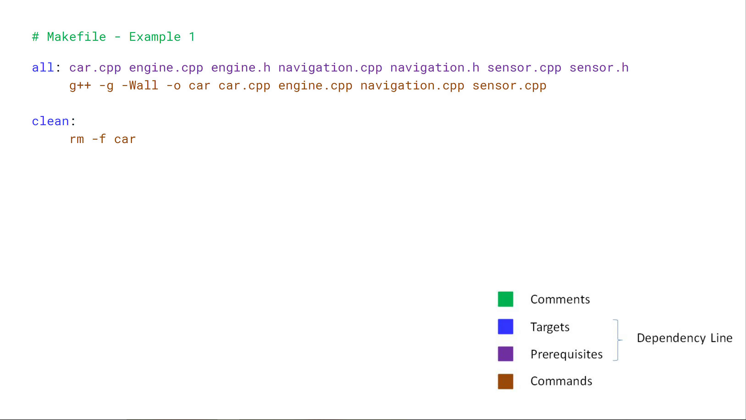
Makefile – Example 1

Slide 49
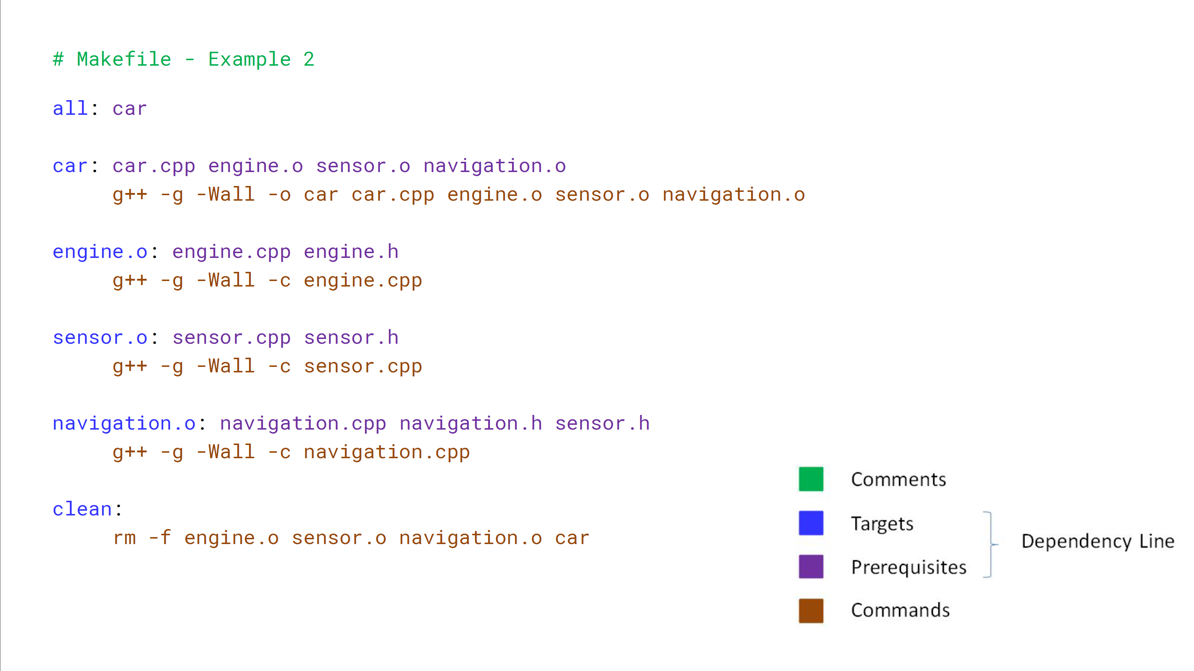

Slide 50
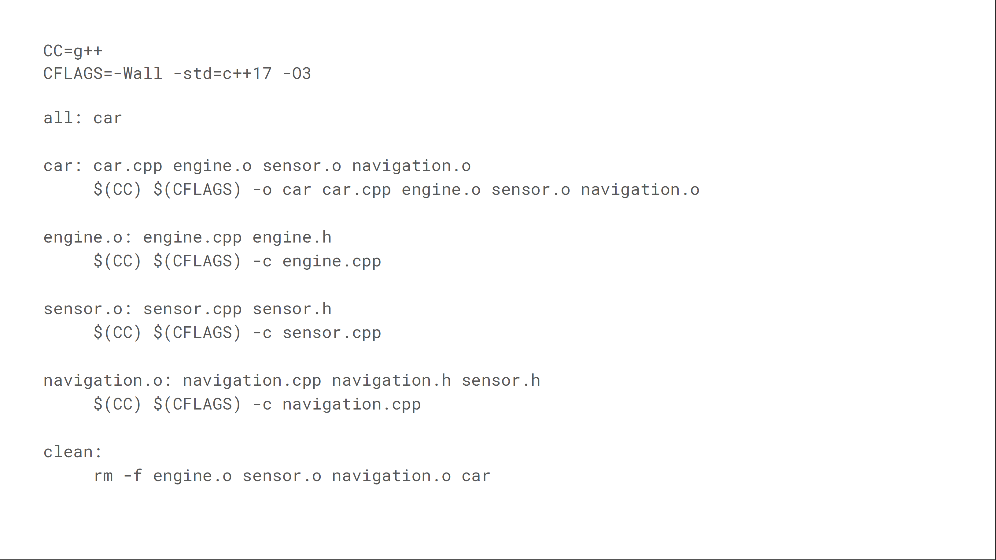

Slide 51
Standard Make commands
When you have a file named just “makefile” then you can access it via Shell commands
Make – compile the default target
Make all – should compile everything
Make install – should install things in the right place
Make clean – should clean things up
Make [target] – call commands for just that group

